Slide 1
Quickcart: Ecommerce web application
By: Azizi, Muthu, Steven & Zahin

Slide 2
TABLE OF CONTENTS
01
02
03
04
05
Background
Functional Specifications
Database Design
Project Specifications
Demo

Slide 3
01
BACKGROUND

Slide 4
BACKGROUND
In today's digital age, online shopping has become increasingly popular, offering convenience and accessibility to everyone.
Our project focuses on building an e-commerce platform to provide user-friendly online shopping experience by allowing users to browse, select, and purchase products with ease.

Slide 5
02
FUNCTIONAL SPECIFICATIONS

Slide 6
FUNCTIONAL SPECIFICATIONS
User can register by providing a display name, strong password, email, and phone number.
The email must be unique for user login.
Registration Page
User can log in to the system using their registered email and password.
Login Page
Displays user profile details and allows users to edit their profile, view order history, or change their password.
User Profile Page

Slide 7
FUNCTIONAL SPECIFICATIONS
Home Page
User can search for products, view product listings, and add items to their cart.
Product Lising Page
Shows product info: name, description, price, images, and review(s).
Add to cart option available.
Social media sharing (WhatsApp, Twitter X, Telegram).
User can leave comments and rate the product.
Product Details Page

Slide 8
FUNCTIONAL SPECIFICATIONS
User can view their selected items, check the total price, and proceed to checkout or continue shopping.
Shopping Cart
Displays order information, including item list, total cost, and options to view order history or return to the shop.
Order Details

Slide 9
03
DATABASE DESIGN

Slide 10
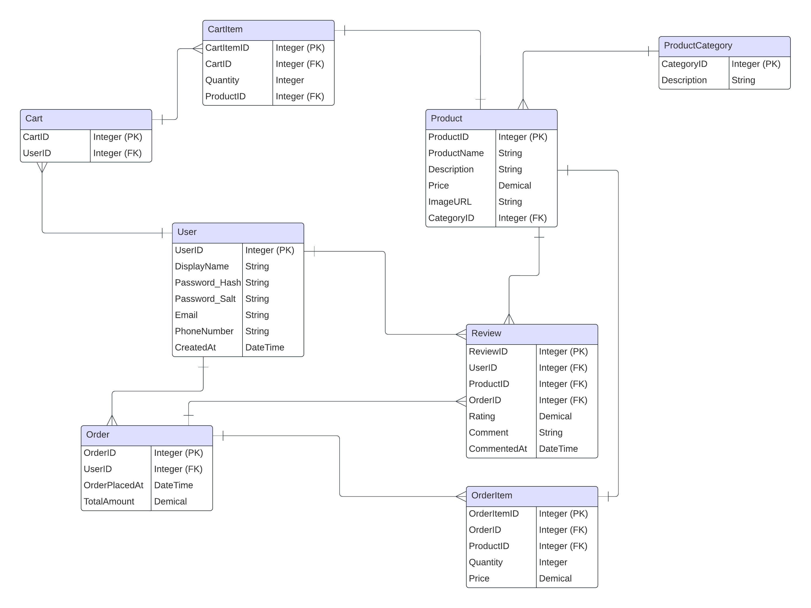
DATABASE DESIGN
User – Cart: 1 to 1 (One user has one cart)
User – Order: 1 to Many (One user can have multiple orders)
User – Order - Review: 1 to Many (One user can submit multiple reviews for a product after placing an order, allowing for additional feedback over time)
Cart – Cart Item: 1 to Many (One cart can have multiple cart items)
Product – Cart Item: 1 to Many (One product can appear in multiple cart items)
Product – Review: 1 to Many (One product can have multiple reviews)
Order – Order Item: 1 to Many (One order can have multiple order items)
Product – Order Item: 1 to Many (One product can appear in multiple order items)
Product – Product Category: Many to 1 (Many products belong to one category)

Slide 11
04
PROJECT SPECIFICATIONS

Slide 12
PROJECT SPECIFICATIONS
Java Version | Server Version | External Referenced Libraries | Version Control | Database
Java SE 22 | Apache Tomcat 10.1 | jackson-databind-2.15.0.jar mysql-connector-java-8.0.26.jar jackson-core-2.15.0.jar jackson-annotations-2.15.0.jar jackson-datatype-jsr310-2.15.0.jar | GitHub | Database: MySQL Instance Type: AWS RDS (Relational Database Service) Cloud Provider: Amazon Web Services (AWS) Endpoint: quickcart.cqojz0ygx2o6.us-east-1.rds.amazonaws.com

Slide 13
05
DEMO

Slide 14
Thank You

